Slide 1
Water Harvesting: Overview, Research & Design
EMC Water Allocation Committee – 18Nov2020
Bill Hunt, Ph.D., PE
WNR Professor & Extension Specialist
NC State University
www.bae.ncsu.edu/stormwater

Slide 2
Hadrian’s Wall
www.bae.ncsu.edu/stormwater

Slide 3
Every 5 Miles – a Roman Fort
Where does the runoff go?
www.bae.ncsu.edu/stormwater

Slide 4
Runoff Captured in a Subterranean Tank
www.bae.ncsu.edu/stormwater

Slide 5
And Used for …
TOILET FLUSHING!!!!
www.bae.ncsu.edu/stormwater

Slide 6
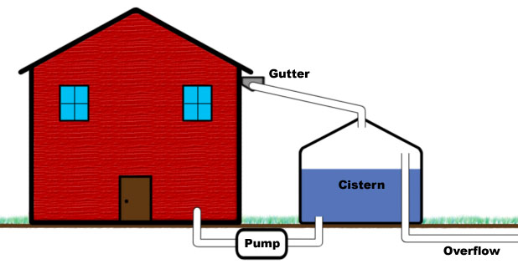
#1. Components of a Water Harvesting System
www.bae.ncsu.edu/stormwater

Slide 7
#1. Components of a Water Harvesting System
Collection System
www.bae.ncsu.edu/stormwater

Slide 8
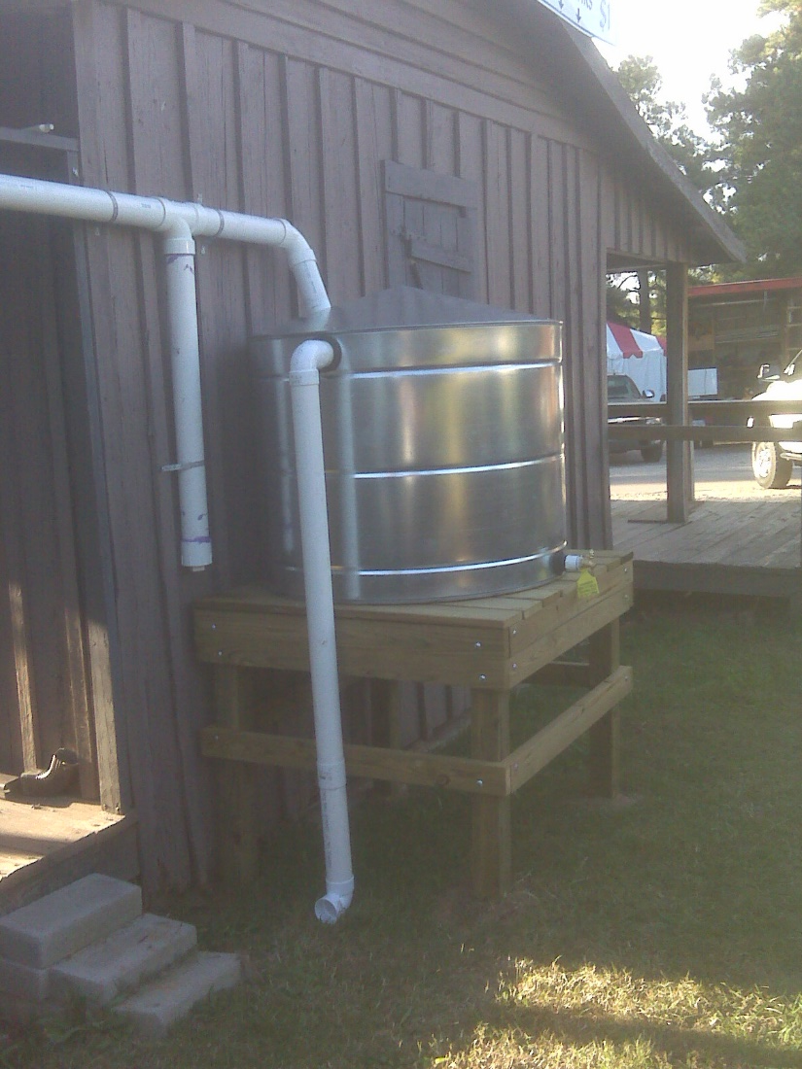
#1. Components of a Water Harvesting System
Pre-Treatment
Minimizes gross solid collection in tank
www.bae.ncsu.edu/stormwater

Slide 9
#1. Components of a Water Harvesting System
Storage Tank/ Volume
www.bae.ncsu.edu/stormwater

Slide 10
#1. Components of a Water Harvesting System
Overflow
www.bae.ncsu.edu/stormwater

Slide 11
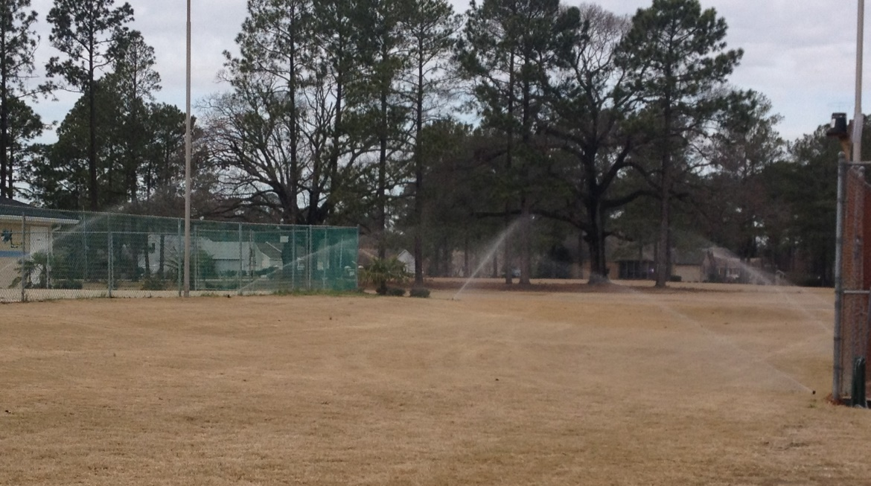
#1. Components of a Water Harvesting System
Distribution System
www.bae.ncsu.edu/stormwater

Slide 12
What are Australasia Drivers?
New Zealand:
Lack of Wells
Lots of Rural Communities
Australia:
10-year Drought
Brisbane Water Supply dropped to 17%
250K RWH systems in QLD, AUS
www.bae.ncsu.edu/stormwater

Slide 13
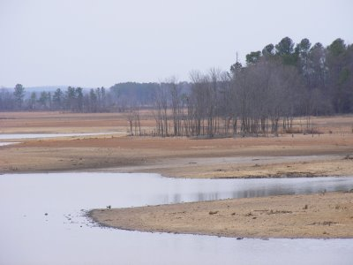
Is It Different in NC?
Source: NC Climate Office
www.bae.ncsu.edu/stormwater

Slide 14
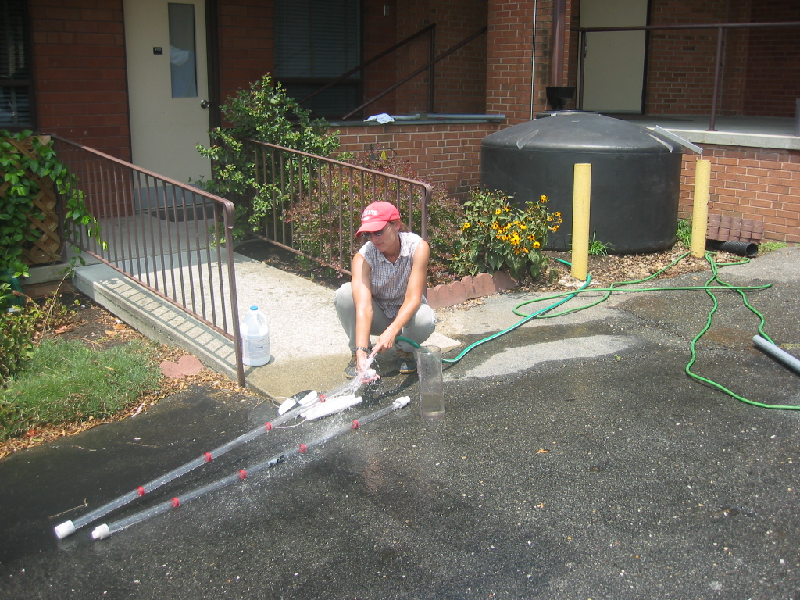
RWH in NC: Goldsboro
www.bae.ncsu.edu/stormwater

Slide 15
RWH in NC: Fayetteville
www.bae.ncsu.edu/stormwater

Slide 16
RWH in NC: Raleigh
www.bae.ncsu.edu/stormwater

Slide 17
Costs of Using Potable Water for Non-potable Use (2009)
Asheville
Charlotte
Fayetteville
Greensboro
Raleigh
Wilmington
$0.0090 / gal
$0.0034 / gal
$0.0035 / gal
$0.0031 / gal
$0.0031 / gal
$0.0053 / gal
Average Residential Cost: $400 per year in Asheville, NC
www.bae.ncsu.edu/stormwater

Slide 18
Unlike Most SCMs: RWH (partially) Pays for Itself
www.bae.ncsu.edu/stormwater

Slide 19
So, Does RWH Work?
www.bae.ncsu.edu/stormwater

Slide 20
Craven County Agricultural Center

Slide 21
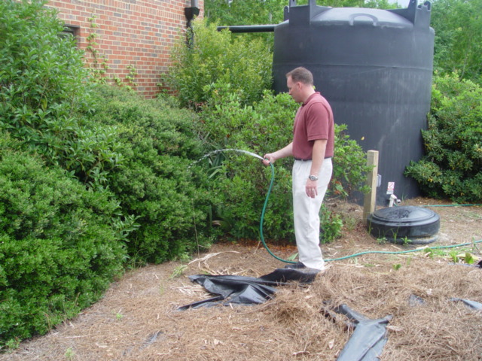

Slide 22
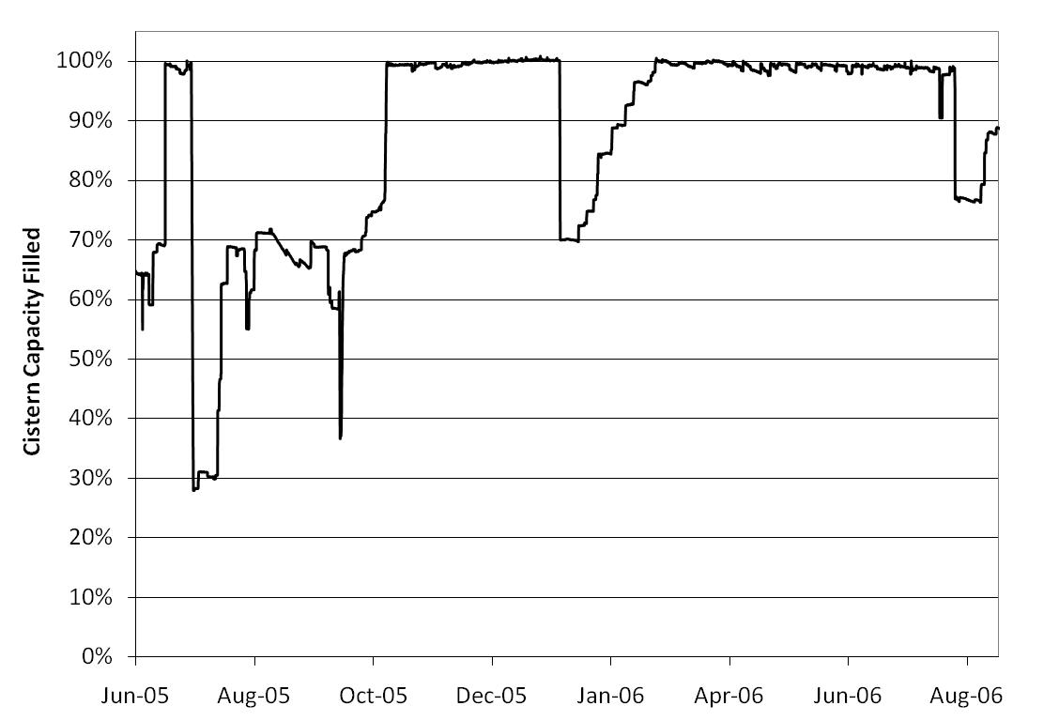
Cistern Use – Craven Co. Ag Center
www.bae.ncsu.edu/stormwater

Slide 23
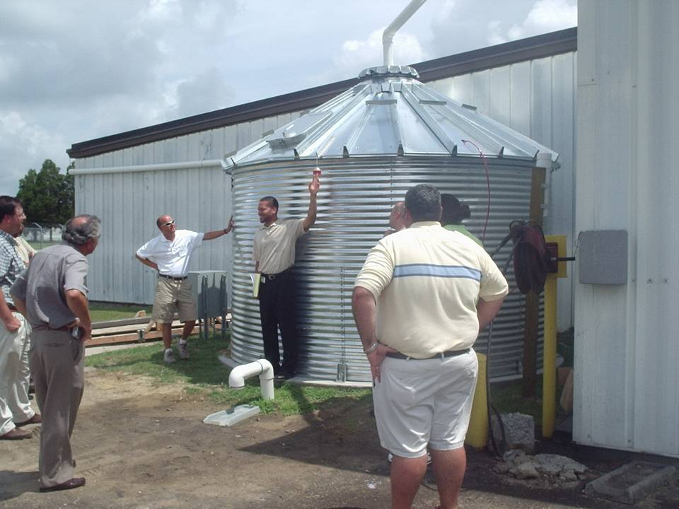

Slide 24
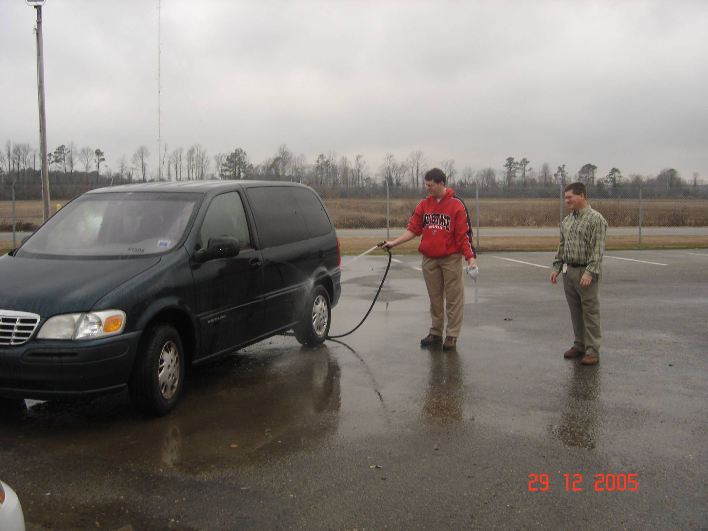

Slide 25
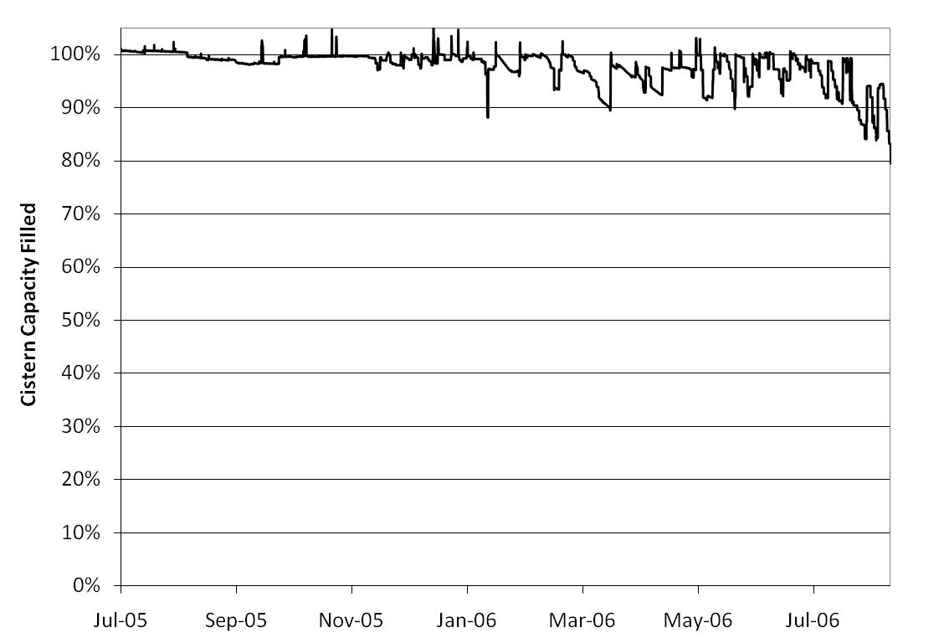
Cistern Use – Kinston Pub. Util.
www.bae.ncsu.edu/stormwater

Slide 26
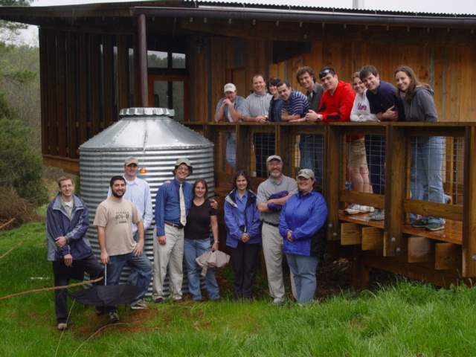
Monitoring @ Prairie Ridge: Wake County

Slide 27
www.bae.ncsu.edu/stormwater

Slide 28
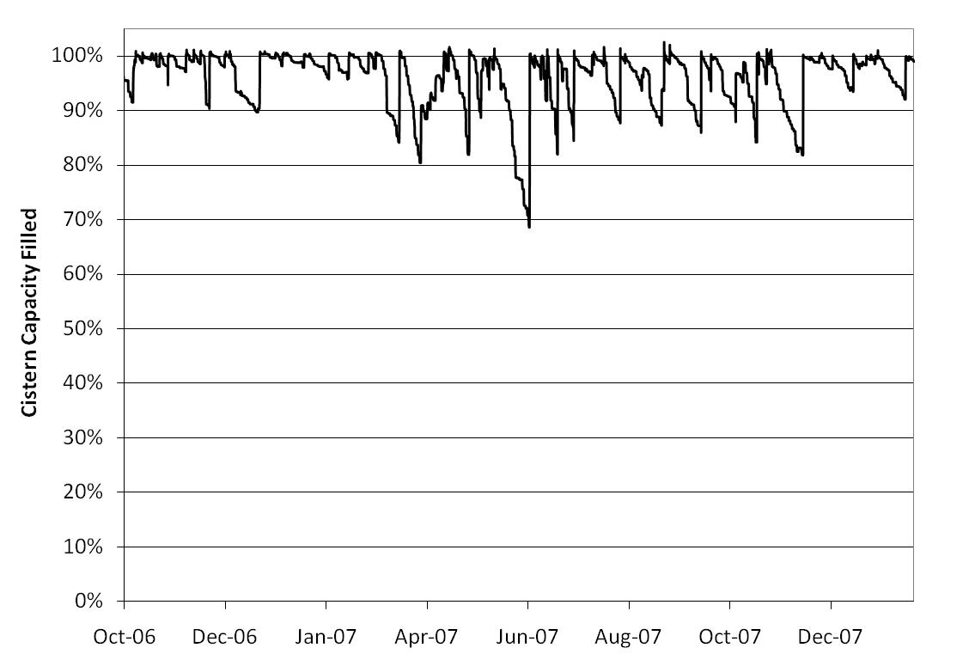
Cistern Use – Prarie Ridge
www.bae.ncsu.edu/stormwater

Slide 29
So, what does all this mean?
We meet our water supply needs
We do not maximize our stormwater management opportunities
www.bae.ncsu.edu/stormwater

Slide 30
Designing/ Operating to Improve Stormwater Management
www.bae.ncsu.edu/stormwater

Slide 31
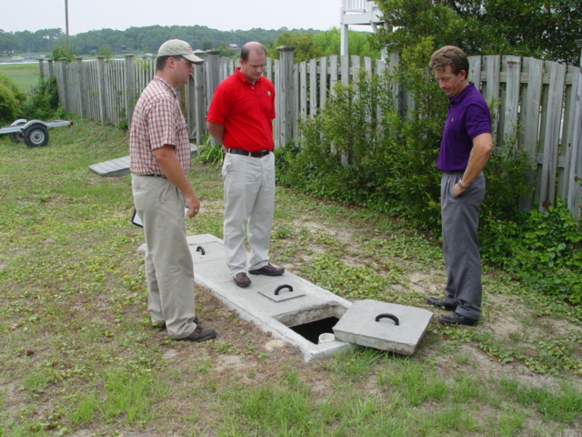
Town of Holden Beach, NC

Slide 32
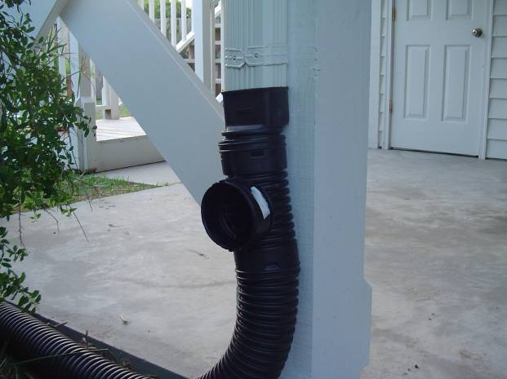
www.bae.ncsu.edu/stormwater

Slide 33
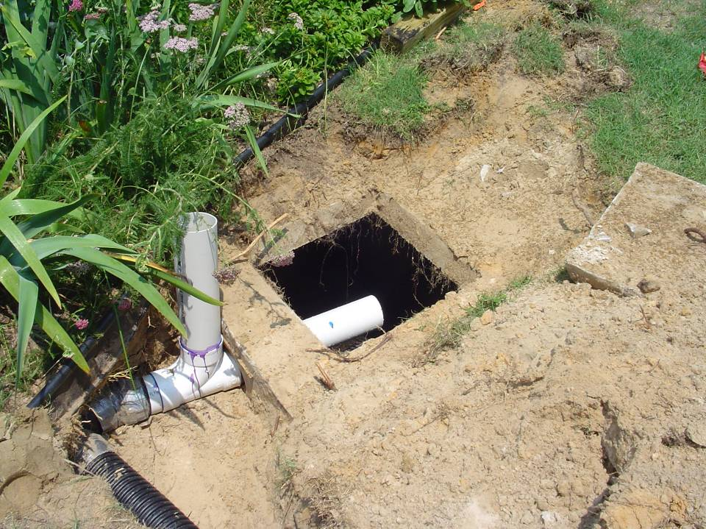

Slide 34
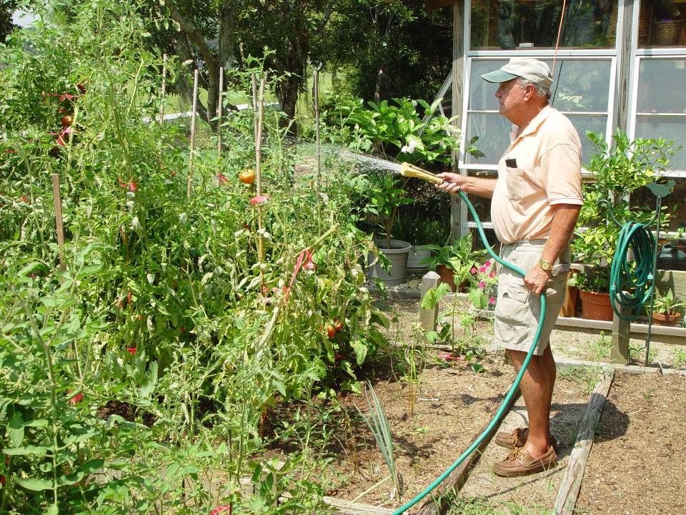
Insert Jack Smith Irrigation

Slide 35
Holden Beach Cistern Water Level : Irrigation of Garden
Water Level (in)
Rainfall (in)
www.bae.ncsu.edu/stormwater

Slide 36
The Key?
Design a Slow Leak into the system?
www.bae.ncsu.edu/stormwater

Slide 37
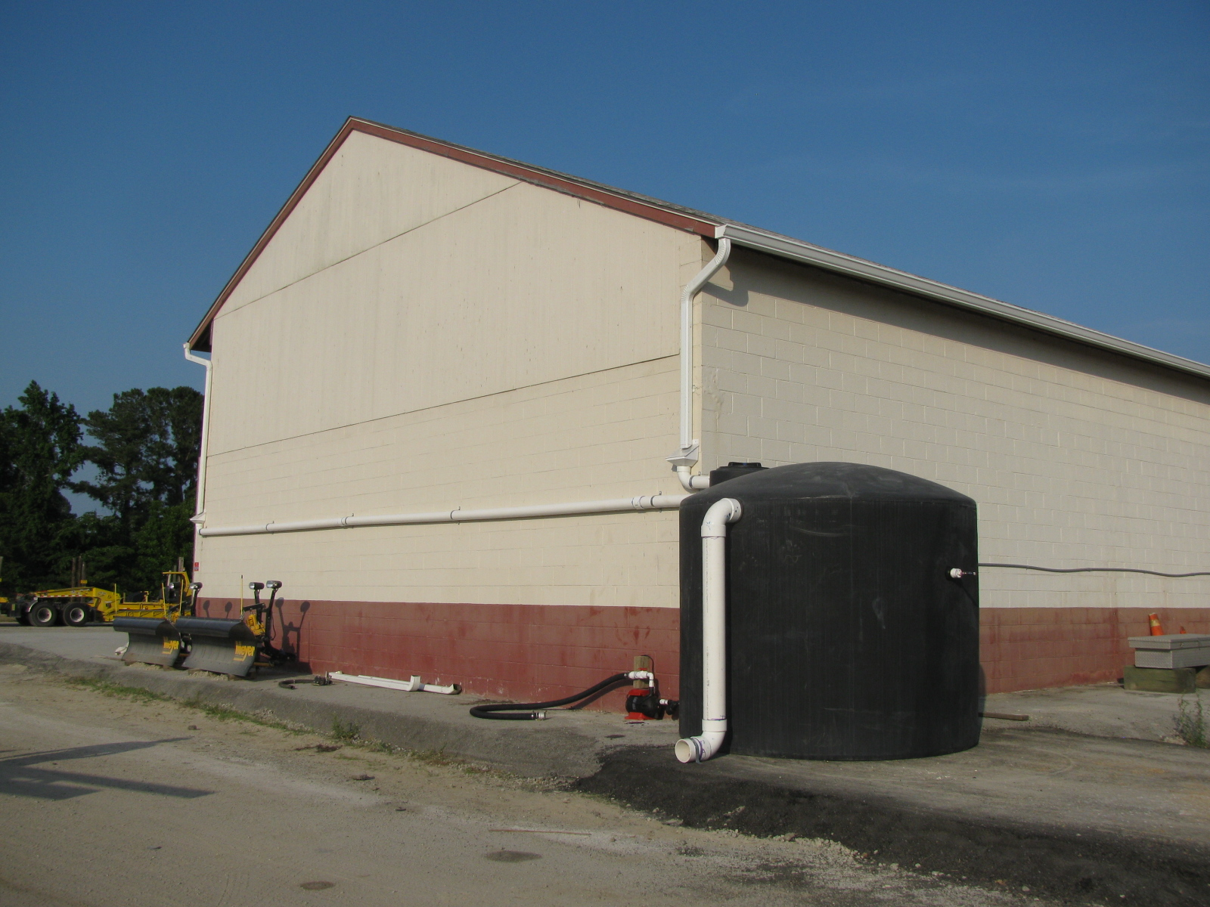
NC Department of Transportation
202 m² roof area
8,330 L tank
Streetsweeping,
equipment filling/washing

Slide 38
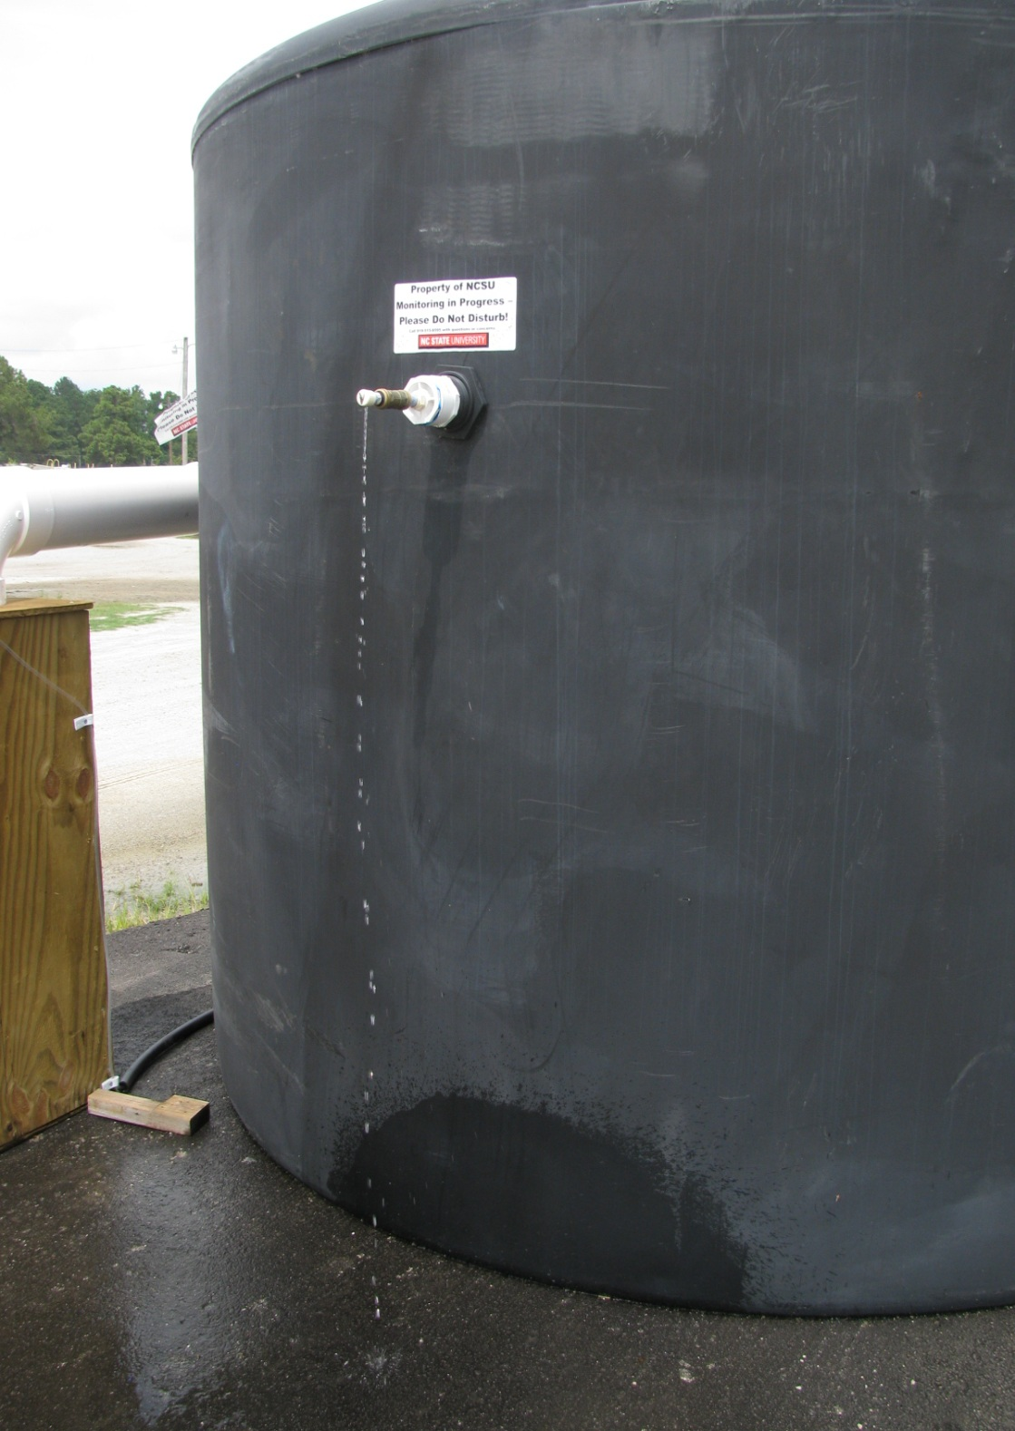
Detention
Detention volume = 2,275 L (~1.1cm)
Retention volume = 6,055 L
Drawdown time = 3 days
Retention
Research Funded by the NC Clean Water Management Trust Fund

Slide 39
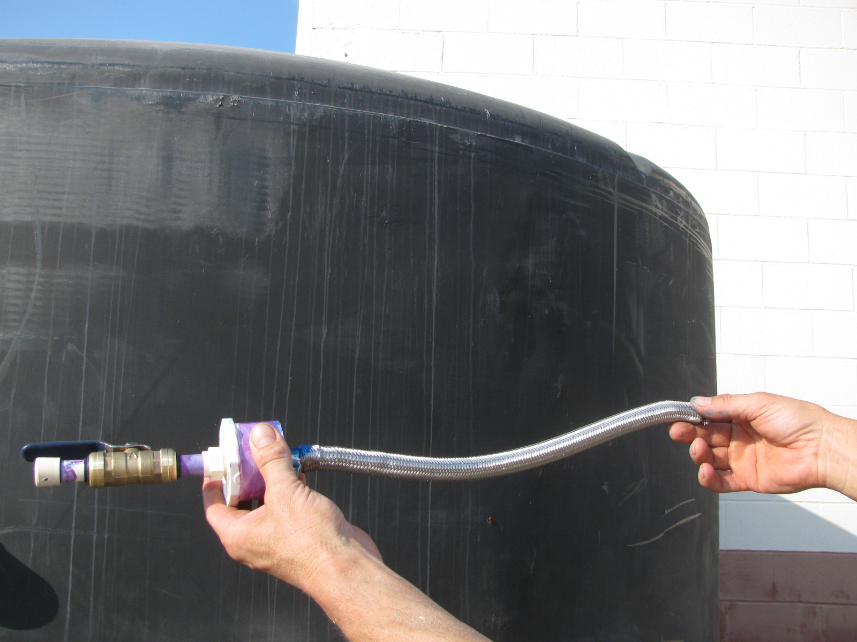
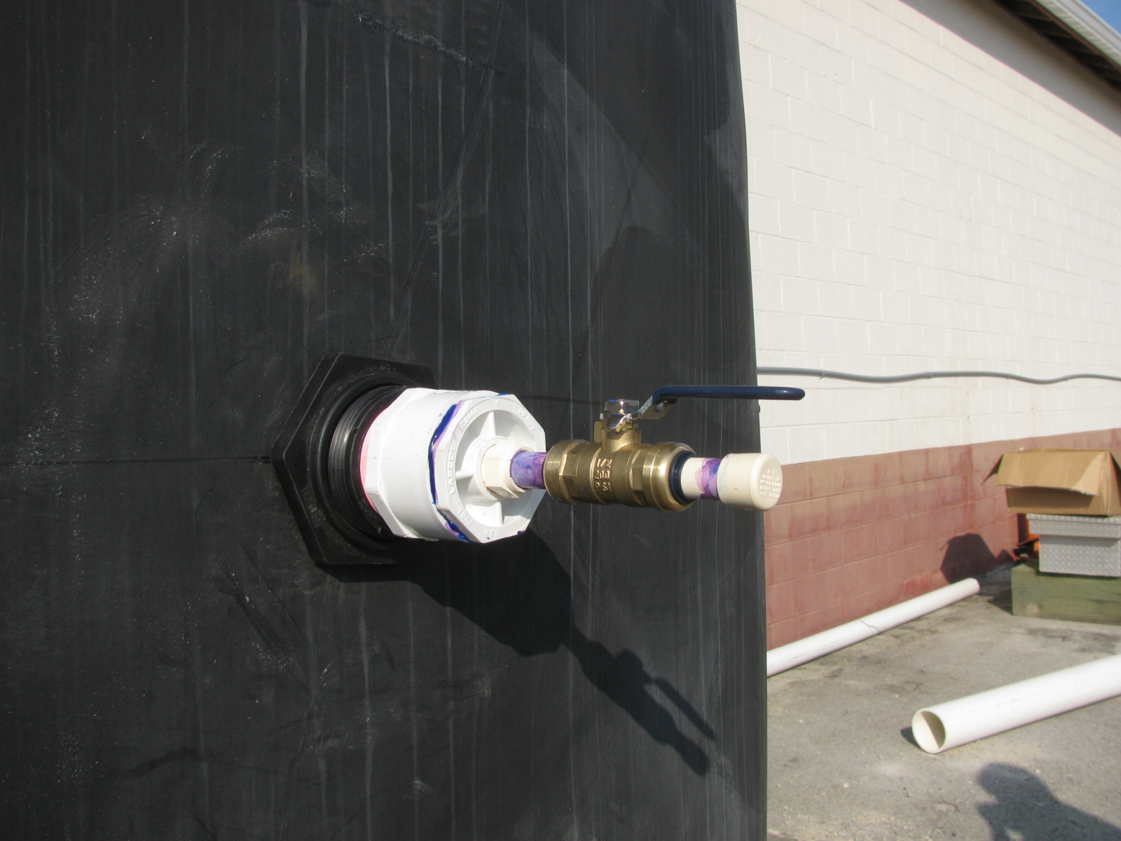

Slide 40
99,310 L Released
59,740 L
Used by NCDOT
82% Volume Reduction

Slide 41
You can design this to capture more
The capture volume had been the correct water quality volume (1” v. 0.5”)
We would have had more space dedicated to rainfall
0.5” v. 1.0”
www.bae.ncsu.edu/stormwater

Slide 42
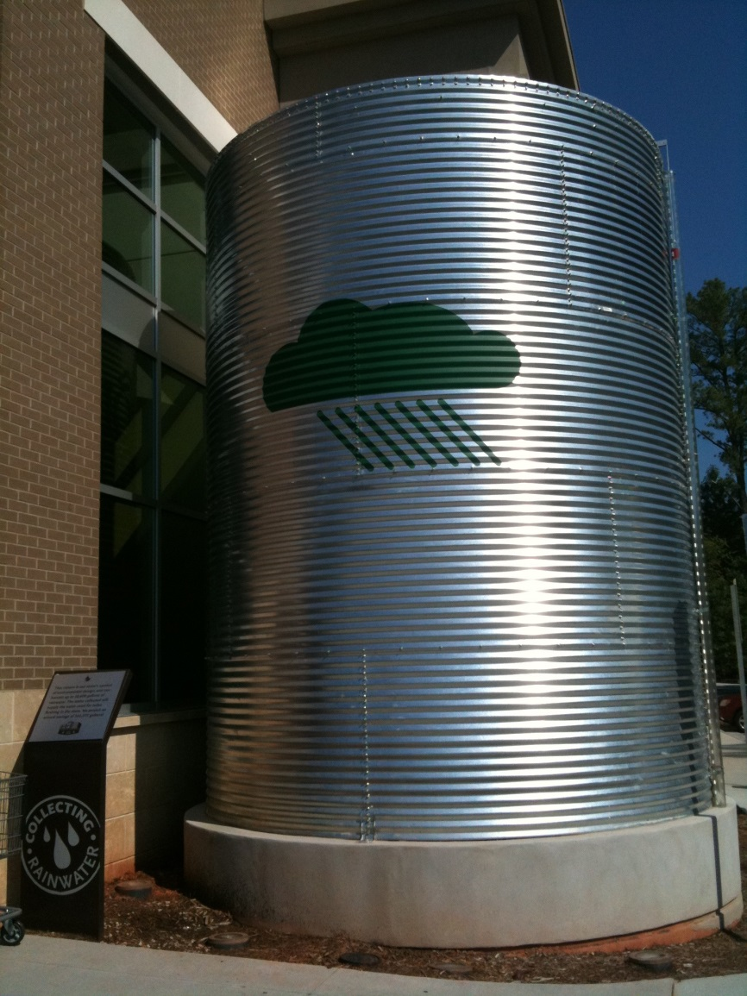
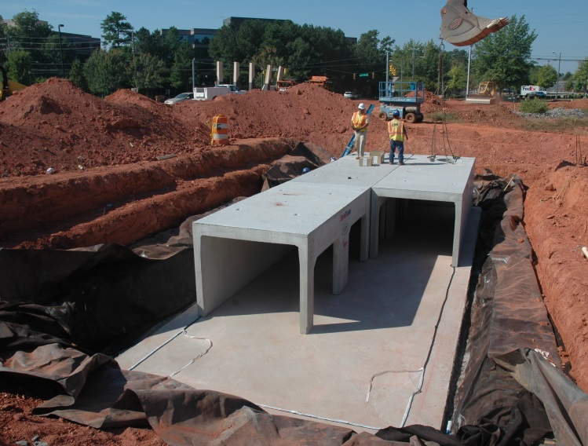
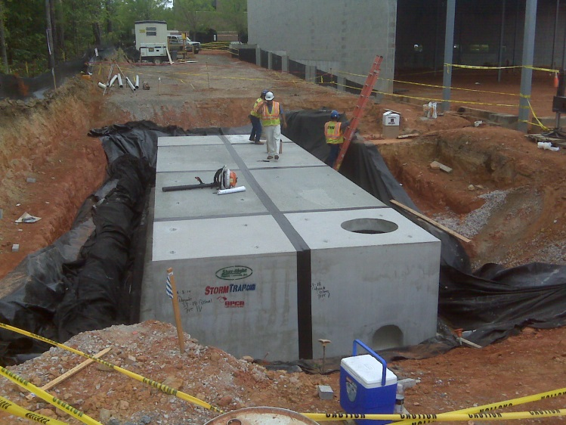
#3. To Receive “Full” Credit: Must Capture 85% of Annual Runoff Volume
www.bae.ncsu.edu/stormwater

Slide 43
Volume Capture: 98%
Rainfall 30.6”
LID Inflow 20.3”
Conv. Inflow 18.4”
Conv. Outflow 9.3”
LID Outflow 0.6”
www.bae.ncsu.edu/stormwater
Notes:
Cumulative runoff volumes were measured and normalized by drainage area to determine runoff depth at each site. Of the 31” of rainfall recorded, 20” entered the LID SCMs, and 18” entered the conventional SCMs. The LID outflowed 0.6” of runoff, infiltrating 97% of stormwater inflow, while the conventional development outflows 9”, infiltrating or evaporating roughly half of the inflow.
Overall, the LID

Slide 44
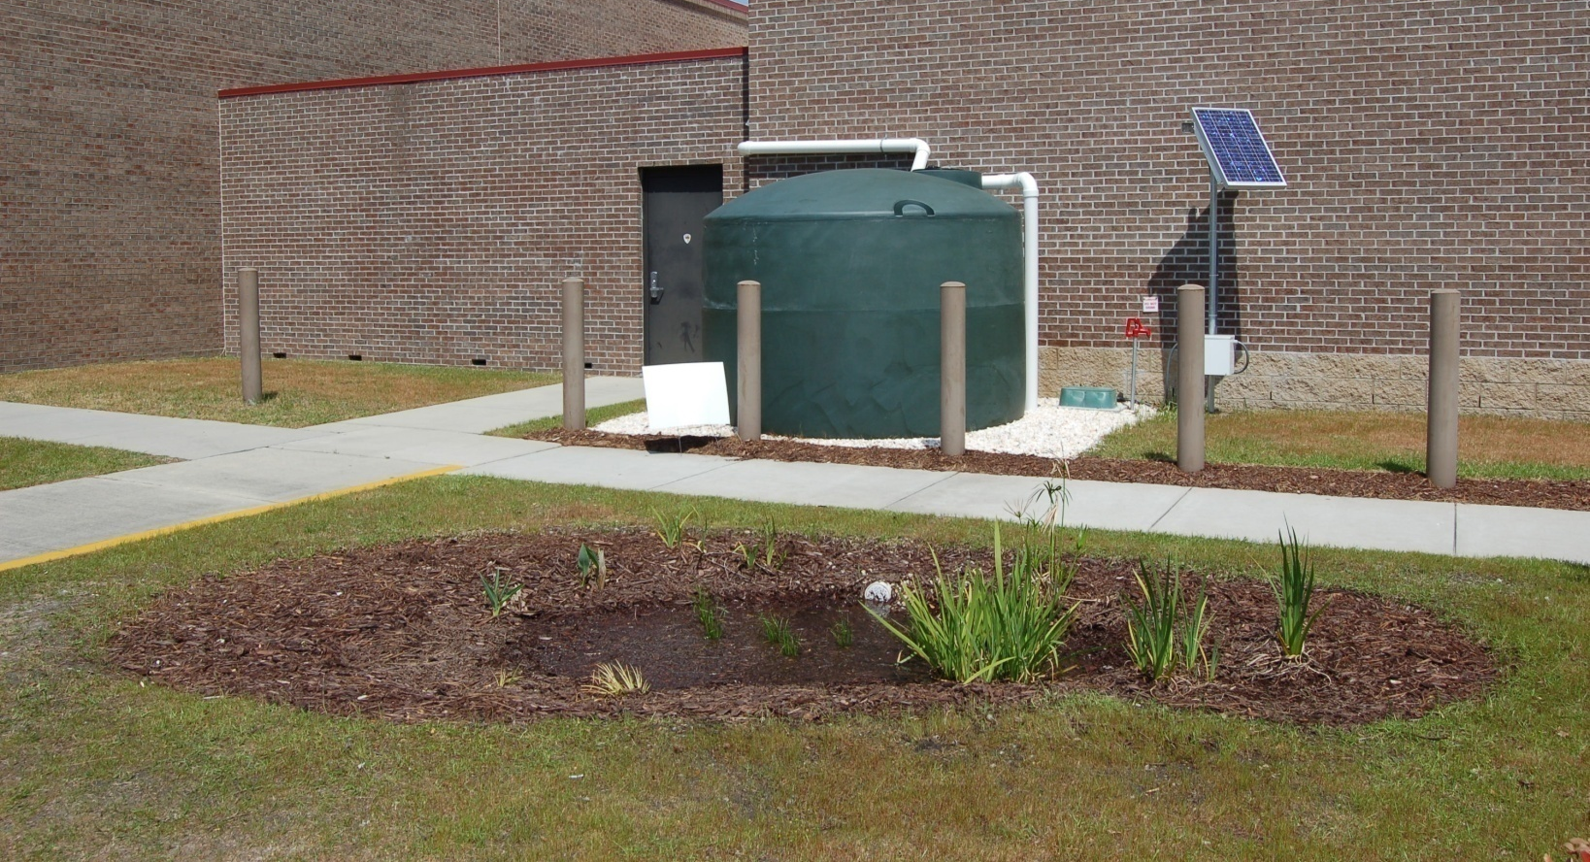
#3. To Receive “Full” Credit: Must Capture 85% of Annual Runoff Volume
But… Smaller systems may be used in conjunction with other SCMs to reduce the design volume of the downstream device.
www.bae.ncsu.edu/stormwater

Slide 45
Passive v. Active Drawdown
Real Time Control v. A Slow Leak
www.bae.ncsu.edu/stormwater

Slide 46
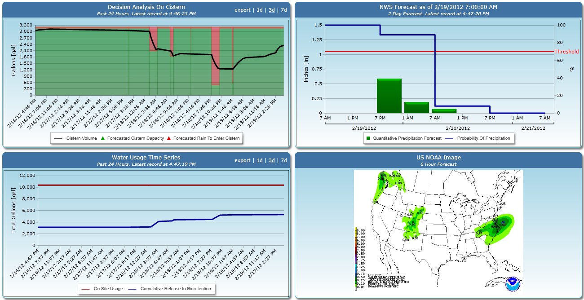

Slide 47
An infiltration zone – destination of released h2o
www.bae.ncsu.edu/stormwater

Slide 48
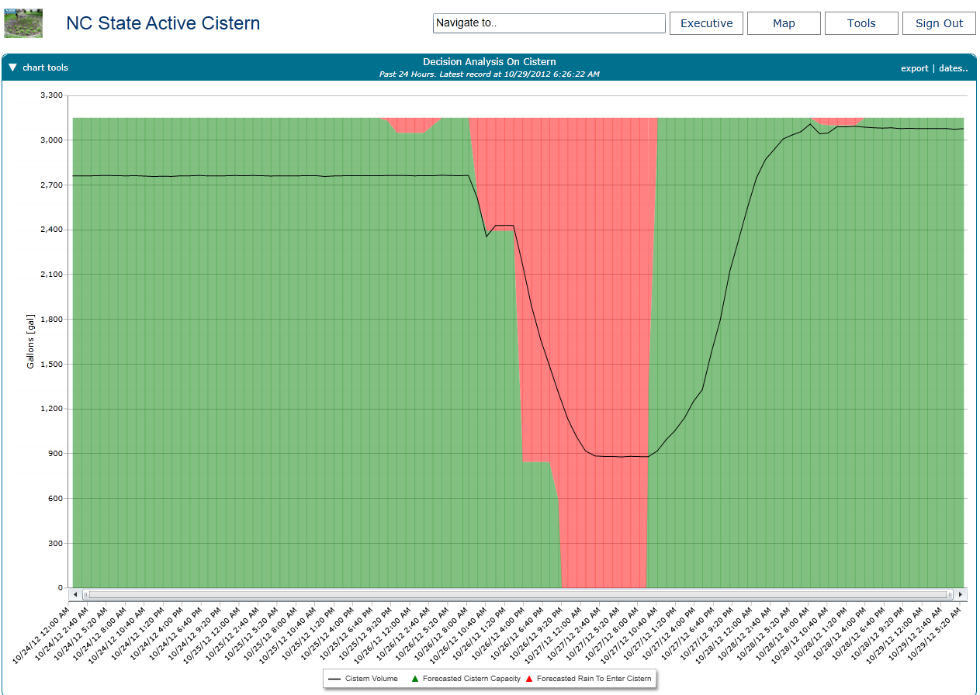
Hurricane Sandy (10/29/12)

Slide 49
The Best Way to Determine Cistern Size is to Run a Model (updated funded by NCDWR)
www.bae.ncsu.edu/stormwater - click downloads
www.bae.ncsu.edu/stormwater

Slide 50
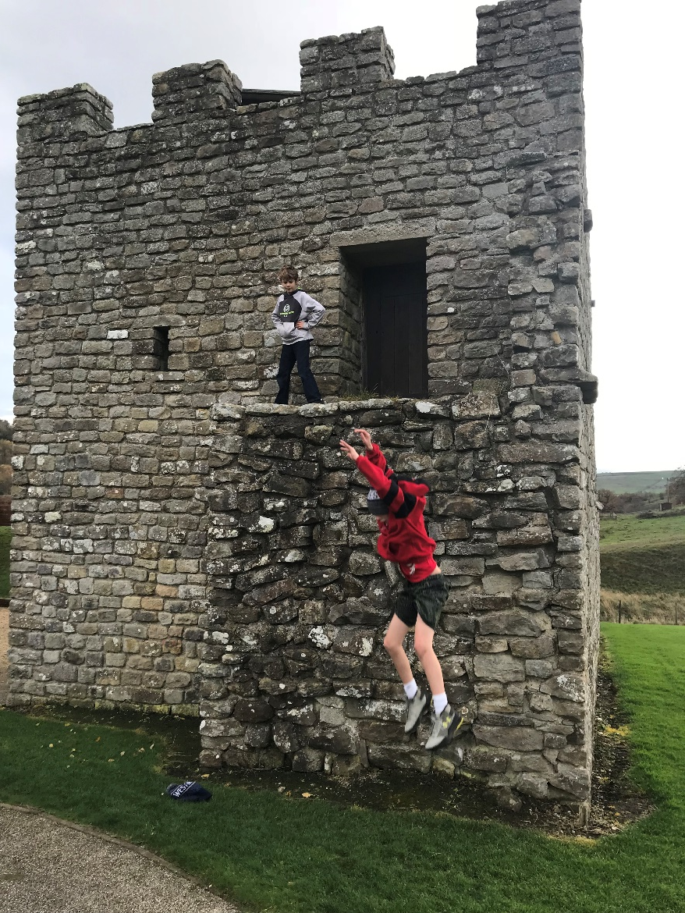
Questions?
www.bae.ncsu.edu/stormwater

